Slide 1
Pathogen lineage dynamics
Theory Module

Slide 2
Outline
What is a pathogen lineage?
What is a pathogen variant?
When are variants or lineages of concern?
SARS-CoV-2 case study

Slide 3
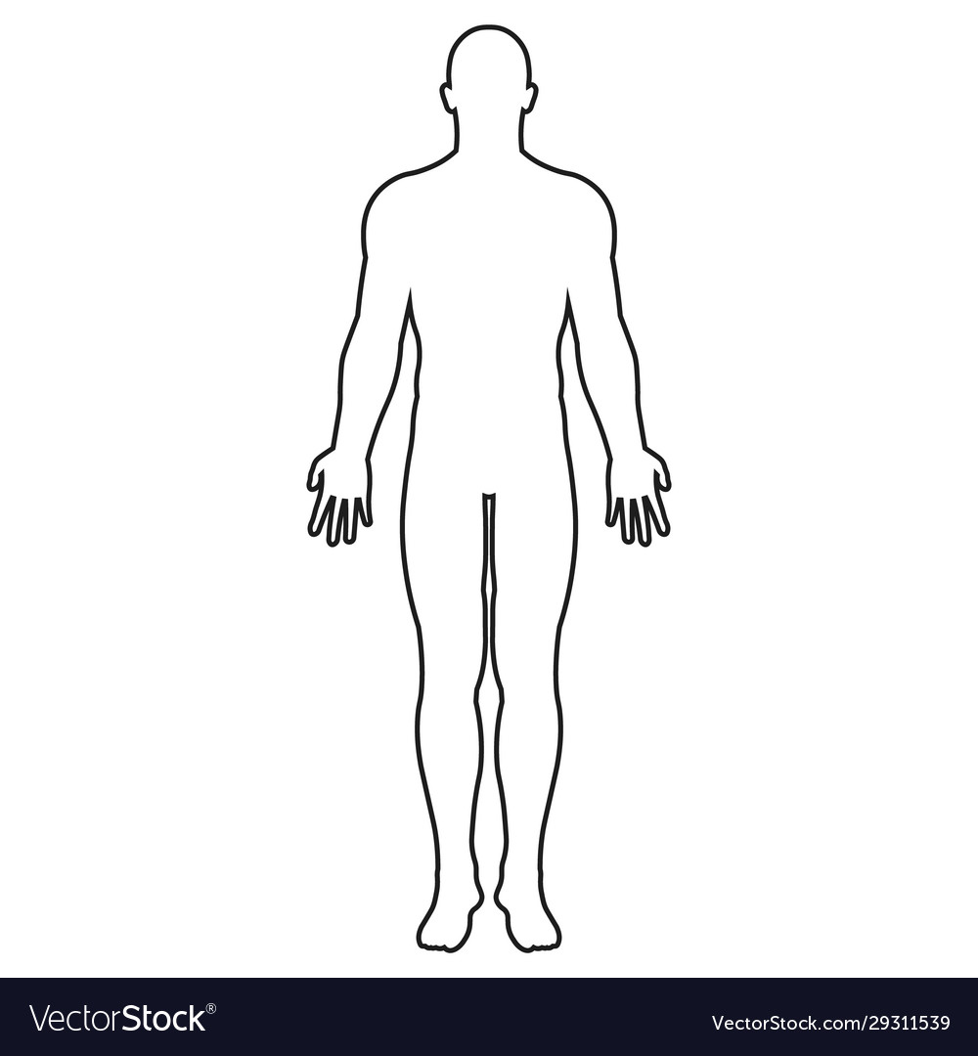



Pathogens evolve continuously
Within host
On a population level
ATTTGC
ATTTGC
CTTTGC
AATTGC
ATTTAC
ATTCGC
TTTTTC
ATTCCC
CTTTGC
CCTTGC
CTTTAC
CTTTAC
CTTTGA
CTTTTC

Slide 4
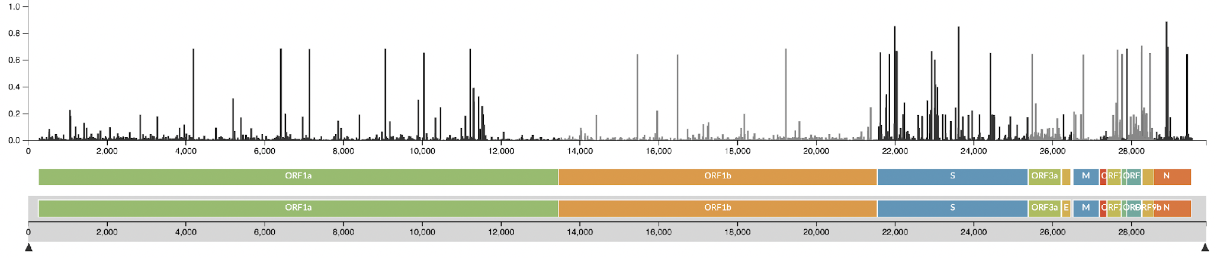
When do mutations matter?
https://nextstrain.org/ncov/gisaid/global
Notes:
A lot of diversity is generated across scales, but when do mutations matter?

Slide 5
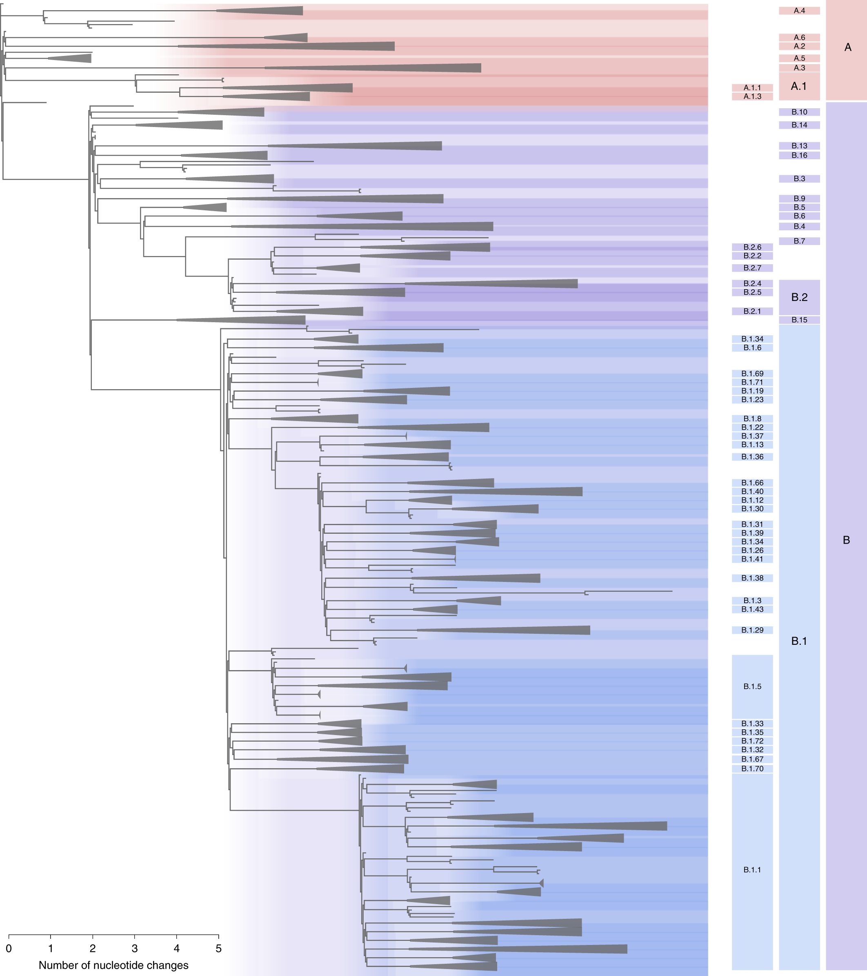
What is a pathogen lineage?
A phylogenetically-defined group of sequences that encompasses ancestors and descendants
Reflects the evolutionary relationships of pathogens
Not always consistently defined across different pathogens
Rambaut et al. 2020.
Useful resource for SARS-CoV-2: https://cov-lineages.org/lineage_list.html
Notes:
Tool for summarising phylogenetic relationships.

Slide 6
What is a variant?
The term variant just means “genetically distinct” and indicates a collection of specific mutations
We are particularly interested in the frequency of variants with mutations that may have functional importance
Notes:
Tool for summarising phylogenetic relationships.
For example, SARS-CoV-2 evolves by an average of two mutations per month on the population-level

Slide 7
What is a variant?
The term variant just means “genetically distinct” and indicates a collection of specific mutations
We are particularly interested in the frequency of variants with mutations that may have functional importance
Pathogens evolve continuously within host and on the population level, so we expect variants to emerge constantly
Notes:
Tool for summarising phylogenetic relationships.
For example, SARS-CoV-2 evolves by an average of two mutations per month on the population-level

Slide 8
Outline
What is a pathogen lineage?
What is a pathogen variant?
When are variants or lineages of concern?
SARS-CoV-2 case study

Slide 9
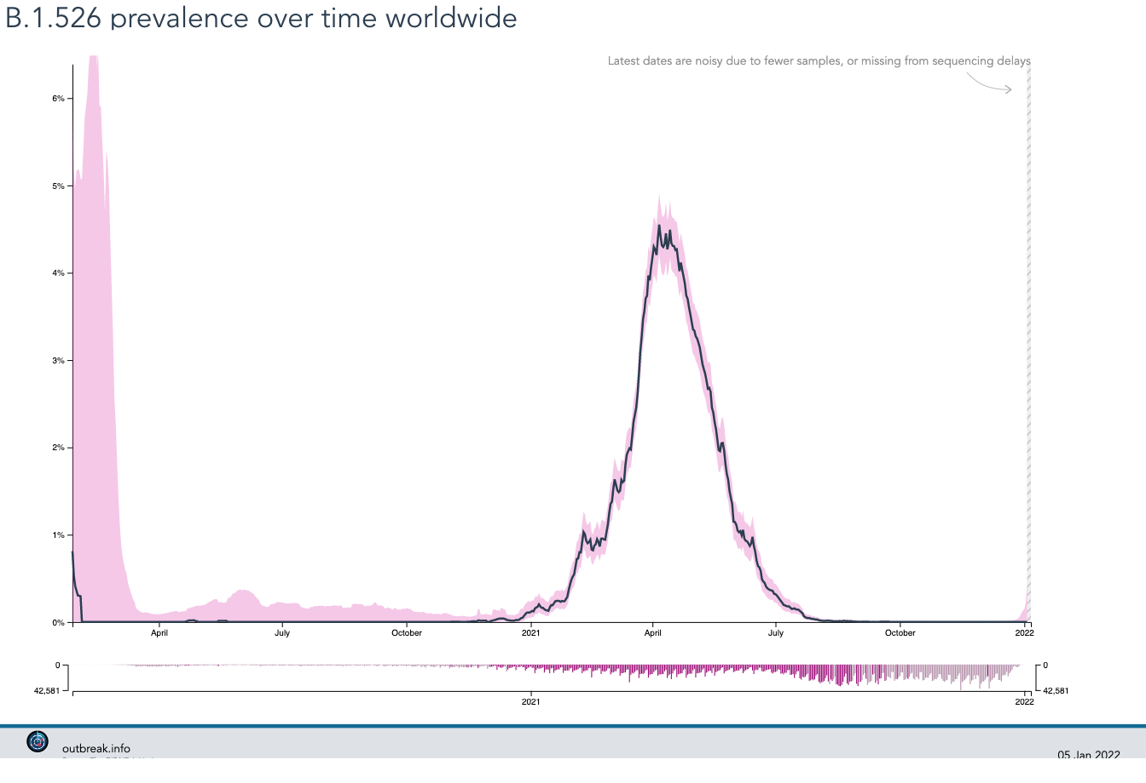
When is a variant of concern?
We expect variants to emerge constantly
We expect variants/lineages to increase and decrease in frequency in the population
https://outbreak.info/situation-reports?pango=B.1.526
Notes:
Tool for summarising phylogenetic relationships.
Concerning increase in frequency?
Did it evolve to transmit better?

Slide 10
When is a variant of concern?
We expect variants to emerge constantly
We expect variants/lineages to increase and decrease in frequency in the population
When should we be concerned if a lineage or variant is increasing in frequency?
https://outbreak.info/situation-reports?pango=B.1.526
Notes:
Tool for summarising phylogenetic relationships.
Concerning increase in frequency?
Did it evolve to transmit better?
(this is an example of SARS-CoV-2 B.1.526, or Iota variant)

Slide 11
When is a variant of concern?
We expect variants to emerge constantly
We expect variants/lineages to increase and decrease in frequency in the population
Concerning increase in frequency.
Did it evolve to transmit better?
When should we be concerned if a lineage or variant is increasing in frequency?
https://outbreak.info/situation-reports?pango=B.1.526
Notes:
Tool for summarising phylogenetic relationships.
Concerning increase in frequency?
Did it evolve to transmit better?
(this is an example of SARS-CoV-2 B.1.526, or Iota variant)

Slide 12
When is a variant of concern?
We expect variants to emerge constantly
We expect variants/lineages to increase and decrease in frequency in the population
Or does something else explain the transient increase in frequency?
When should we be concerned if a lineage or variant is increasing in frequency?
https://outbreak.info/situation-reports?pango=B.1.526
Notes:
Tool for summarising phylogenetic relationships.
Concerning increase in frequency?
Did it evolve to transmit better?
(this is an example of SARS-CoV-2 B.1.526, or Iota variant)

Slide 13
What is a growth rate?
Not necessarily biological
Context dependent
Increased growth != increased transmissibility
Affected by sampling biases

Slide 14
What explains an increase in lineage frequency?
1. Inherent increased transmissibility
Notes:
We expect them to arise all the time. How do we asses them.

Slide 15
What explains an increase in lineage frequency?
2. Immune escape
High number of re-infections in populations with standing immunity from vaccines or previous outbreak waves
Notes:
We expect them to arise all the time. How do we asses them.

Slide 16
What explains an increase in lineage frequency?
3. Epidemiological amplification
Relaxed non-pharmaceutical interventions resulting in extensive human contact
Variant spreading in very mobile/densely networked populations
Super-spreader events
Notes:
We expect them to arise all the time. How do we asses them.

Slide 17
What explains an increase in lineage frequency?
4. Non-random sampling
Outbreak investigations
All cases are travelers
Molecular screening for specific variants
Geographic biases
Only sampling hospitals
Notes:
We expect them to arise all the time. How do we asses them.

Slide 18
What explains an increase in lineage frequency?
5. Founder effect
Notes:
We expect them to arise all the time. How do we asses them.

Slide 19

What explains an increase in lineage frequency?
5. Founder effect
Notes:
We expect them to arise all the time. How do we asses them.

Slide 20
What explains the increase in frequency?
Inherent increased transmissibility
Immune escape
Epidemiological amplification
Non-random sampling
Founder effect
Unseen confounders
Notes:
We expect them to arise all the time. How do we asses them.

Slide 21
What explains the increase in frequency?
Inherent increased transmissibility
Immune escape
Epidemiological amplification
Non-random sampling
Founder effect
Unseen confounders
Notes:
We expect them to arise all the time. How do we asses them.

Slide 22
Outline
What is a pathogen lineage?
What is a pathogen variant?
When are variants or lineages of concern?
SARS-CoV-2 case study

Slide 23
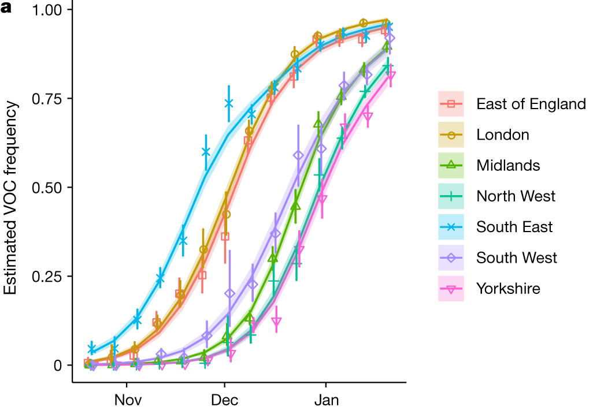
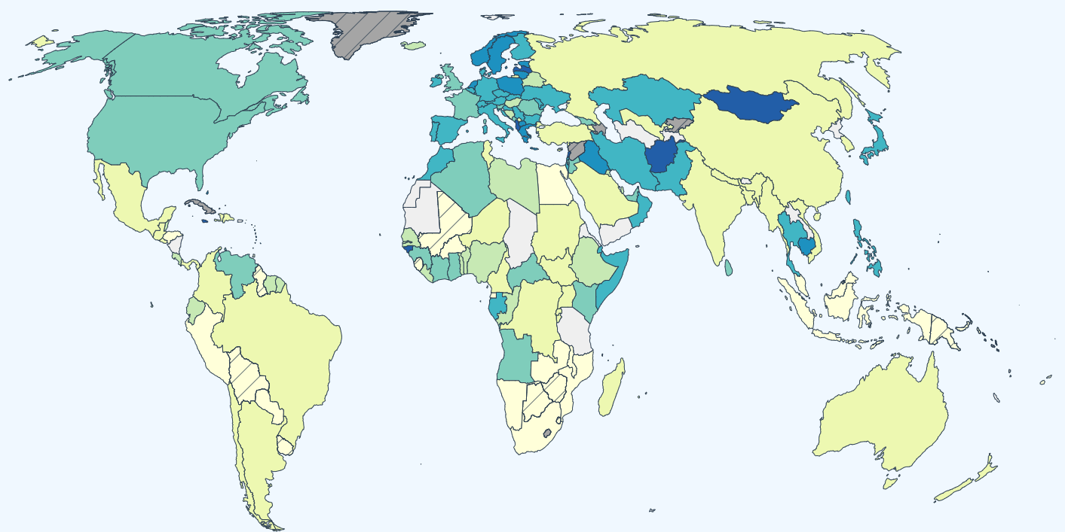
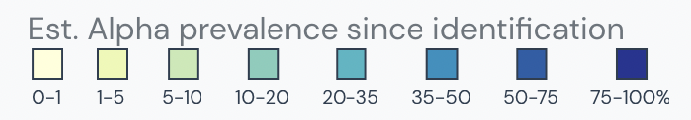
SARS-CoV-2 B.1.1.7 (Alpha variant)
B.1.1.7 spread rapidly from November 2020 to January 2021
Volz et al. 2021.
https://outbreak.info/situation-reports/alpha
Notes:
Very genetically distinct : LONG BRANCH – undersampling, or something weirder?
Not not just silent substitutions – in non-synonymous in spike
This variant is estimated to have first emerged in the UK during September 2020.
SGTF: 69/70 deletion: occurred spontaneously many times and likely leads to a conformational change in the spike protein.
Deletion ∆H69/∆V70 in spike has arisen in multiple independent lineages of SARS-CoV-2, is linked to immune escape in immunocompromised patients, and enhances viral infectivity in vitro
P681H: near the S1/S2 furin cleavage site, a site with high variability in coronaviruses. This mutation has also emerged spontaneously multiple times.

Slide 24
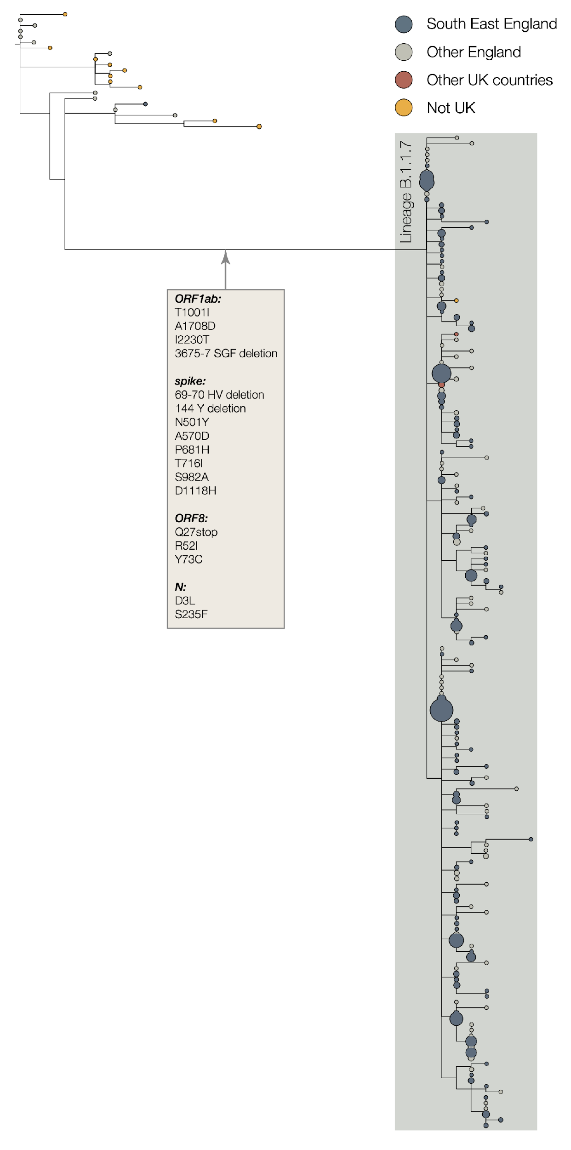
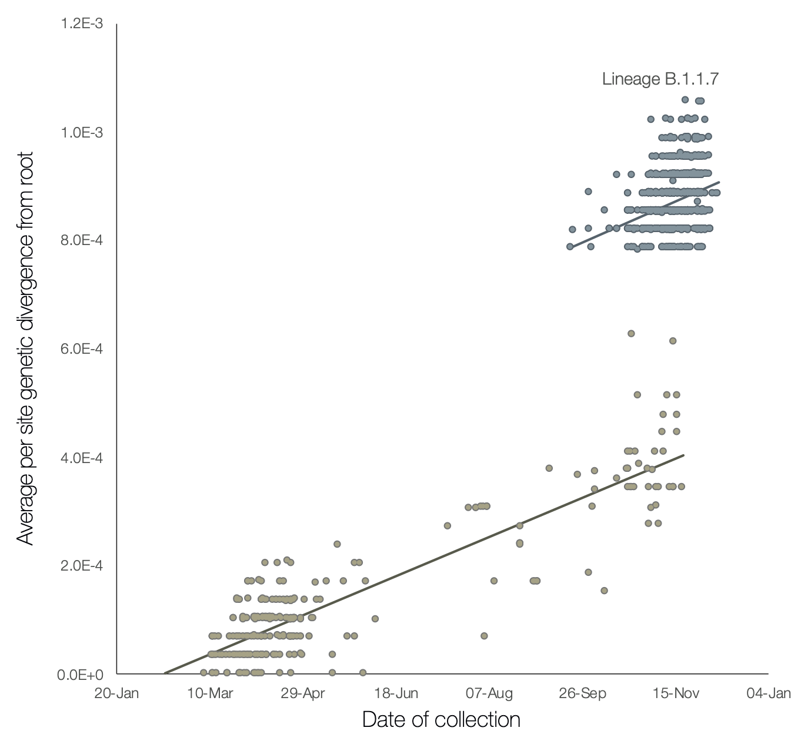
SARS-CoV-2 B.1.1.7 (Alpha variant)
B.1.1.7 was extremely genetically distinct
https://virological.org/t/preliminary-genomic-characterisation-of-an-emergent-sars-cov-2-lineage-in-the-uk-defined-by-a-novel-set-of-spike-mutations/563
Notes:
THIS SLIDE COULD USE SOME ARROWS TO MAKE CLEAR WHAT PARTS ARE IMPORTANT
Very genetically distinct : LONG BRANCH – undersampling, or something weirder?
Not not just silent substitutions – in non-synonymous in spike
This variant is estimated to have first emerged in the UK during September 2020.
SGTF: 69/70 deletion: occurred spontaneously many times and likely leads to a conformational change in the spike protein.
Deletion ∆H69/∆V70 in spike has arisen in multiple independent lineages of SARS-CoV-2, is linked to immune escape in immunocompromised patients, and enhances viral infectivity in vitro
P681H: near the S1/S2 furin cleavage site, a site with high variability in coronaviruses. This mutation has also emerged spontaneously multiple times.

Slide 25
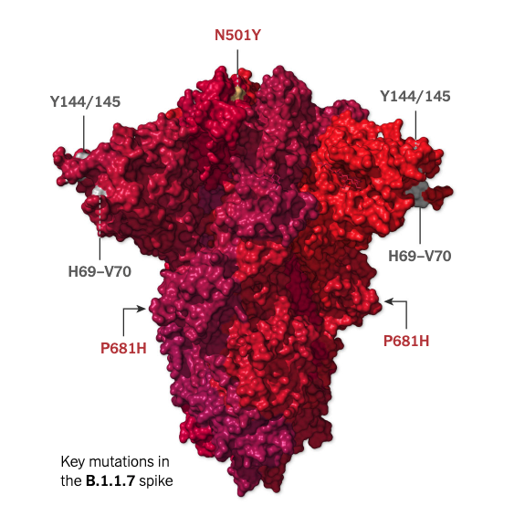
Mutations of functional importance in B.1.1.7
Characteristic mutations:
gene | amino acid
ORF1a | T1001I
ORF1a | A1708D
ORF1a | I2230T
ORF1a | del3675/3677
ORF1b | P314L
S | del69/70
S | del144/145
S | N501Y
S | A570D
S | D614D
S | P681H
gene | amino acid
S | T716I
S | S982A
S | D1118H
ORF8 | Q27*
ORF8 | R52I
ORF8 | Y73C
N | D3L
N | R203K
N | G204R
N | S235F
https://virological.org/t/preliminary-genomic-characterisation-of-an-emergent-sars-cov-2-lineage-in-the-uk-defined-by-a-novel-set-of-spike-mutations/563
Notes:
Very genetically distinct : LONG BRANCH – undersampling, or something weirder?
Not not just silent substitutions – in non-synonymous in spike
This variant is estimated to have first emerged in the UK during September 2020.
SGTF: 69/70 deletion: occurred spontaneously many times and likely leads to a conformational change in the spike protein.
Deletion ∆H69/∆V70 in spike has arisen in multiple independent lineages of SARS-CoV-2, is linked to immune escape in immunocompromised patients, and enhances viral infectivity in vitro
P681H: near the S1/S2 furin cleavage site, a site with high variability in coronaviruses. This mutation has also emerged spontaneously multiple times.

Slide 26
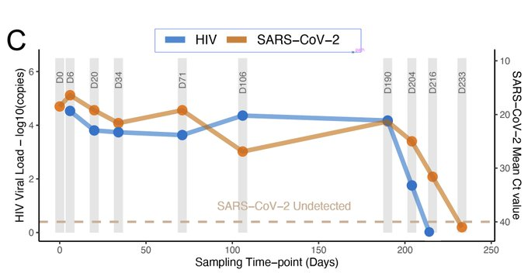
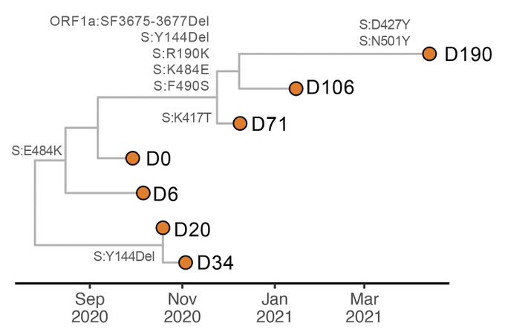
Persistent infections in immunocompromised patients
More time to evolve?
Treatment with monoclonal antibodies => more reason to evolve?
SARS-CoV-2 RT-PCR was positive for 216 days
30 mutations accumulated over time
Karim et al. 2021.
Notes:
Despite a short clinical illness of moderate severity, SARS-CoV-2 PCR positivity persisted up to 216 days. We demonstrate significant shifts in the virus population over that time, involving multiple mutations at key neutralizing antibody sites in the spike RBD & NTD

Slide 27
What explains the increased lineage frequency?
Inherent increased transmissibility
Immune escape
Epidemiological amplification
Non-random sampling
Founder effect
Unseen confounders
gene | amino acid
ORF1a | T1001I
ORF1a | A1708D
ORF1a | I2230T
ORF1a | del3675/3677
ORF1b | P314L
S | del69/70
S | del144/145
S | N501Y
S | A570D
S | D614D
S | P681H
gene | amino acid
S | T716I
S | S982A
S | D1118H
ORF8 | Q27*
ORF8 | R52I
ORF8 | Y73C
N | D3L
N | R203K
N | G204R
N | S235F
https://outbreak.info/situation-reports/alpha
Notes:
PLEASE CONFIRM HIGHLIGHTED POSITIONS (or change as needed as you write script)
The greater R_{t} estimates of the VOC, even where R_{t} of non-VOC variants was below 1, indicates that B.1.1.7 has a transmission advantage,
Severity: Studies have suggested the B.1.1.7 lineage is more likely to land infected people in the hospital and is deadlier than the original virus.

Slide 28
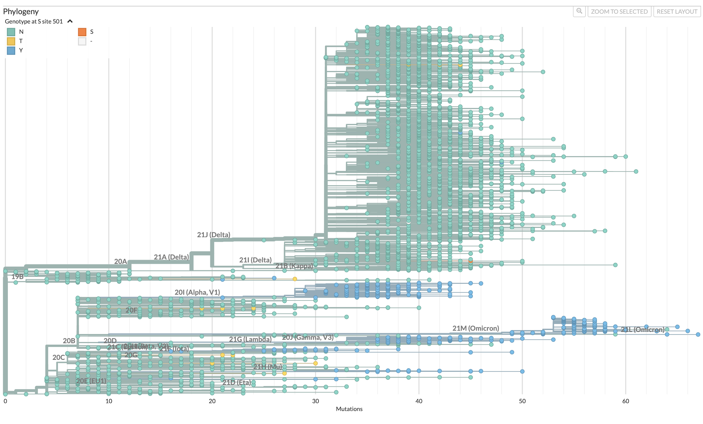
Convergent evolution can signify functional importance
N501Y
https://nextstrain.org/ncov/gisaid/global
Notes:
Emerged independently of B.1.1.7
Potential edit- remove “frequently” from title, and/ or replace “include a few” with “some” so font can be increased (30 pt. minimum)
First identified in South Africa in December: coast of the Eastern Cape Province after the first wave of the epidemic – STANDING IMMUNITY
This variant shares some mutations with B.1.1.7.
1st wave plasma does not neutralize well 501Y.V2 (B.1.351) - 3.2 to 41.9 reduction.
— K417N, which also helps the virus bind more tightly to human cells.
— E484K, which may help the virus evade some kinds of antibodies.
Currently there is no evidence to suggest that this variant has any impact on disease severity.

Slide 29
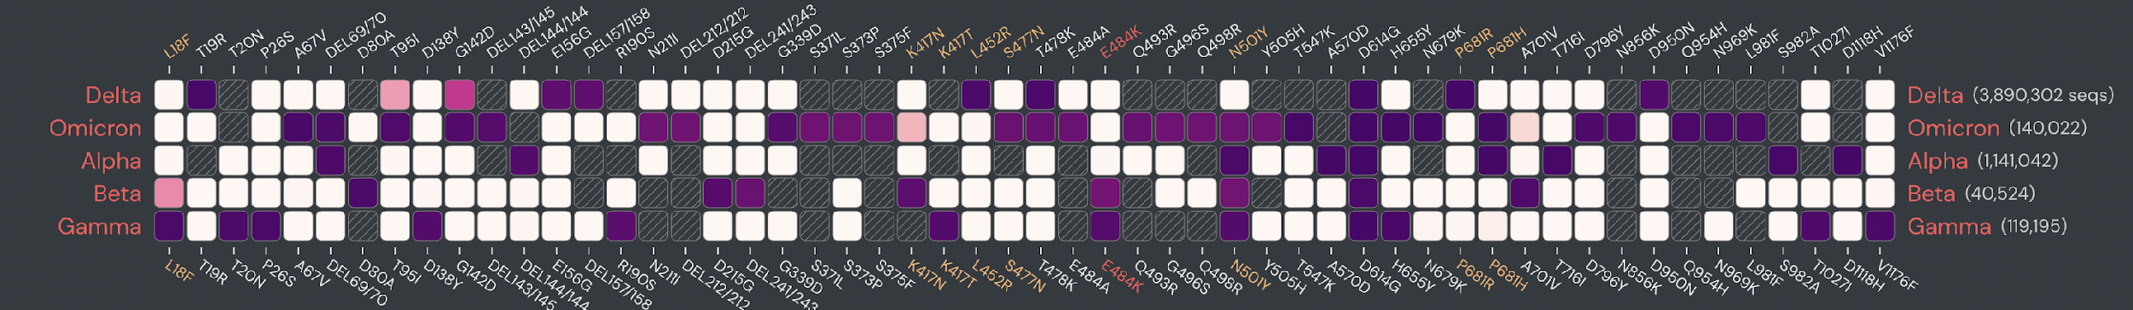
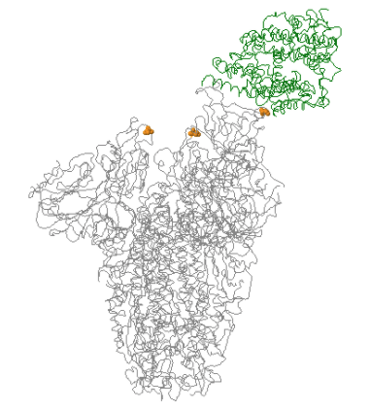
Convergent evolution can signify functional importance
N501Y is in the receptor binding domain (RBD) of the spike glycoprotein, which is important to ACE2 binding and antibody recognition
Opens up conformation to increase ACE binding
https://covariants.org/
https://outbreak.info/
Notes:
Emerged independently of B.1.1.7
First identified in South Africa in December: coast of the Eastern Cape Province after the first wave of the epidemic – STANDING IMMUNITY
This variant shares some mutations with B.1.1.7.
1st wave plasma does not neutralize well 501Y.V2 (B.1.351) - 3.2 to 41.9 reduction.
— K417N, which also helps the virus bind more tightly to human cells.
— E484K, which may help the virus evade some kinds of antibodies.
Currently there is no evidence to suggest that this variant has any impact on disease severity.

Slide 30
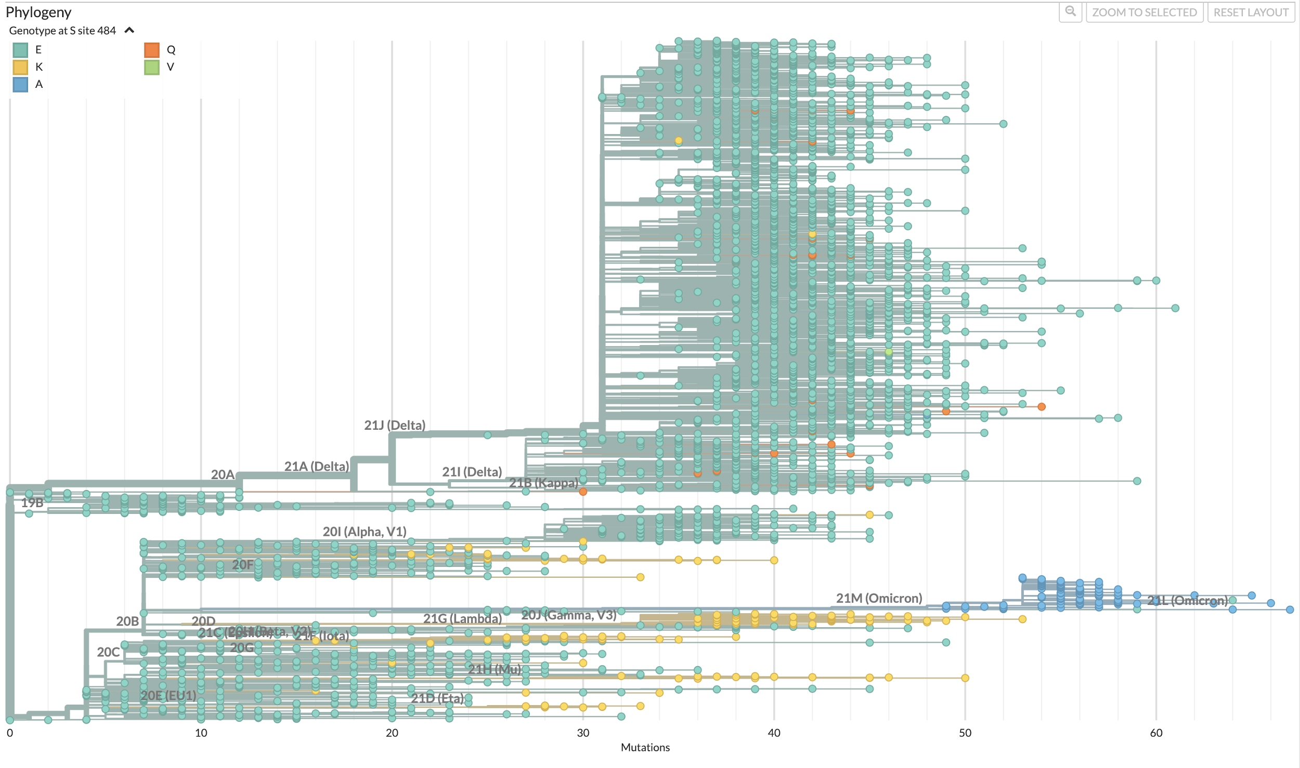
E484K: another example of convergent evolution
https://nextstrain.org/sars-cov-2/
Notes:
The specific mutation S:E484K is found in 4 variants (2 of them "Variants of Concern") reported at the end of 2020/beginning of 2021, in:
South Africa (20H/501Y.V2 or B.1.351)
Brazil ( 20J/501Y.V3 or P.1)
Brazil (20B/S:484K or P.2) (see below)
India (21A/S:154K or B.1.617.1)
has appeared multiple times independently around the world: each can be associated with different accompanying mutations
There is some evidence to indicate that one of the spike protein mutations, E484K, may affect neutralization by some polyclonal and monoclonal antibodies.^{[4],[5]}
MONITOR FOR VACCINE DISTRIBUTION

Slide 31
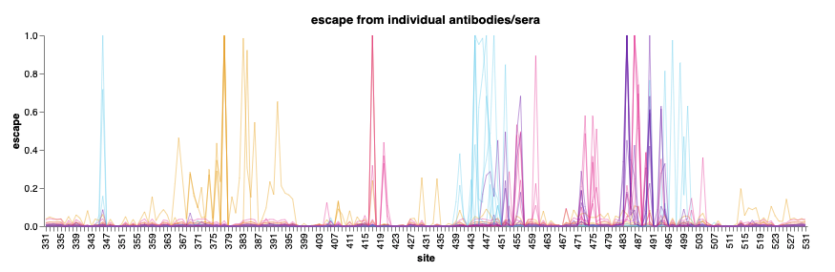
E484K: another example of convergent evolution
E484K is in the receptor binding domain of the spike glycoprotein
E484K reduces antibody neutralization, driving immune escape
https://jbloomlab.github.io/SARS2_RBD_Ab_escape_maps/
https://outbreak.info/
Notes:
The specific mutation S:E484K is found in 4 variants (2 of them "Variants of Concern") reported at the end of 2020/beginning of 2021, in:
South Africa (20H/501Y.V2 or B.1.351)
Brazil ( 20J/501Y.V3 or P.1)
Brazil (20B/S:484K or P.2) (see below)
India (21A/S:154K or B.1.617.1)
has appeared multiple times independently around the world: each can be associated with different accompanying mutations
There is some evidence to indicate that one of the spike protein mutations, E484K, may affect neutralization by some polyclonal and monoclonal antibodies.^{[4],[5]}
MONITOR FOR VACCINE DISTRIBUTION

Slide 32
What explains the increased lineage frequency?
Inherent increased transmissibility
Immune escape
Epidemiological amplification
Non-random sampling
Founder effect
Unseen confounders
Notes:
The greater R_{t} estimates of the VOC, even where R_{t} of non-VOC variants was below 1, indicates that B.1.1.7 has a transmission advantage,
Severity: Studies have suggested the B.1.1.7 lineage is more likely to land infected people in the hospital and is deadlier than the original virus.

Slide 33
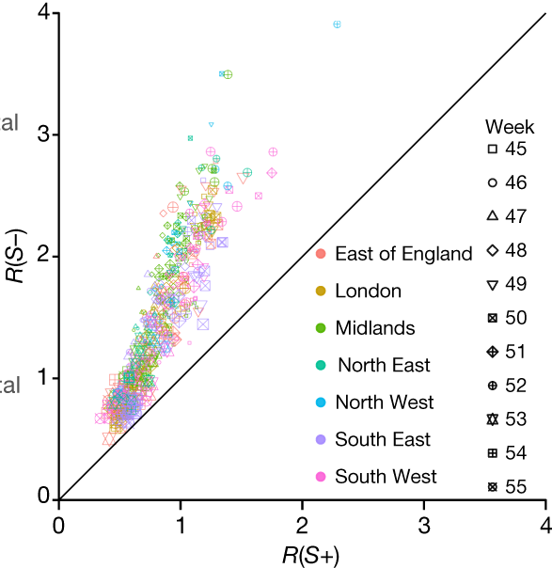
What explains the increased lineage frequency?
B.1.1.7 has a transmission advantage
gene | amino acid
ORF1a | T1001I
ORF1a | A1708D
ORF1a | I2230T
ORF1a | del3675/3677
ORF1b | P314L
S | del69/70
S | del144/145
S | N501Y
S | A570D
S | D614D
S | P681H
gene | amino acid
S | T716I
S | S982A
S | D1118H
ORF8 | Q27*
ORF8 | R52I
ORF8 | Y73C
N | D3L
N | R203K
N | G204R
N | S235F
Volz et al. 2021
Notes:
The greater R_{t} estimates of the VOC, even where R_{t} of non-VOC variants was below 1, indicates that B.1.1.7 has a transmission advantage,
Severity: Studies have suggested the B.1.1.7 lineage is more likely to land infected people in the hospital and is deadlier than the original virus.

Slide 34
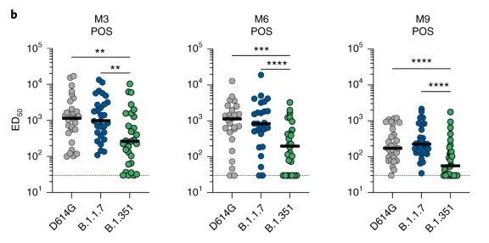
What explains the increased lineage frequency?
B.1.1.7 does not have strong immune escape
gene | amino acid
ORF1a | T1001I
ORF1a | A1708D
ORF1a | I2230T
ORF1a | del3675/3677
ORF1b | P314L
S | del69/70
S | del144/145
S | N501Y
S | A570D
S | D614D
S | P681H
gene | amino acid
S | T716I
S | S982A
S | D1118H
ORF8 | Q27*
ORF8 | R52I
ORF8 | Y73C
N | D3L
N | R203K
N | G204R
N | S235F
Planas et al. 2021
Notes:
The greater R_{t} estimates of the VOC, even where R_{t} of non-VOC variants was below 1, indicates that B.1.1.7 has a transmission advantage,
Severity: Studies have suggested the B.1.1.7 lineage is more likely to land infected people in the hospital and is deadlier than the original virus.
Feedback: MM changed this Slide

Slide 35
What explains the increase in frequency?
Inherent increased transmissibility
Immune escape
Epidemiological amplification
Non-random sampling
Founder effect
Unseen confounders
Notes:
We expect them to arise all the time. How do we asses them.
Remember: Just because a mutation contributes to one trait e.g. immune escape does not mean it was selected for it.
Selected for e.g. receptor binding, transmissibility?
Or chance or epistasis (when mutations need to work together) or pleiotropic (they serve multiple other fitness functions?)

Slide 36
Summary
We expect new lineages and variants to naturally arise regularly
Lineages/variants increase in frequency for many reasons, including founder effects, epidemiological amplification or inherent virological traits
We need to assess why a variant increased in frequency before we make conclusions about its properties

